Slide 1

FA-550 Data Visualization Application
Guided By : Professor Brian Moriarty

Slide 2
About The Data
Our dataset ranges from 1 January 2020 – 15th November 2021 and has approximately 130K records. It is an enormous dataset with an extensive set number of columns. For our research, we have filtered our data as per the requirement and have taken only selected columns of interest:
Column Name | Description | Value
Country | Specifies the name of each country | String - “India”
Date | Gives everyday date | Date - 01/11/2020
New Death | No of deaths on a particular date | Numeric- 275
New Cases | No of cases on a particular day | Numeric- 5234
Fully Vaccinated | Percentage of People vaccinated till date | Percentage- 3.2%
Positive Rate | The share of Covid-19 that are positive | Percentage- 7.4%
Data Set : https://github.com/owid/covid-19-data/tree/master/public/data/
Tableau Public : https://public.tableau.com/app/profile/dhruv2392/viz/COVID-19_16523232724410/COVID-19ANALYSIS?publish=yes

Slide 3
Visualization Tool Choice
Tableau is a powerful Data Visualization software, and much of its popularity is due to its interactive visualizations & user-friendly interface. The primary tool for this analysis will be Tableau.
Combining Tableau’s visualization will help us get a bird’s-eye view of the covid-19 scenario. I will be leveraging Tableau for time series analysis and ease of creating varied graph types.

Slide 4
Research Question
Visualization Map of Covid 19 Cases: The visual would depicts the countries that were infected by covid-19 virus?
Countries with highest cases: To display top 5 countries with most covid cases from January 2020 till September 2021?
Analysis comparing the vaccination percentage with the positive rate and also new cases and deaths reported over the span of the two quarters (Q1 & Q2)?
How lockdown effect seems to have a positive effect on mitigating the covid 19?
Comparison between the percentage of People vaccinated with single dose and fully vaccinated for the top 3 countries with the most covid 19 cases?

Slide 5
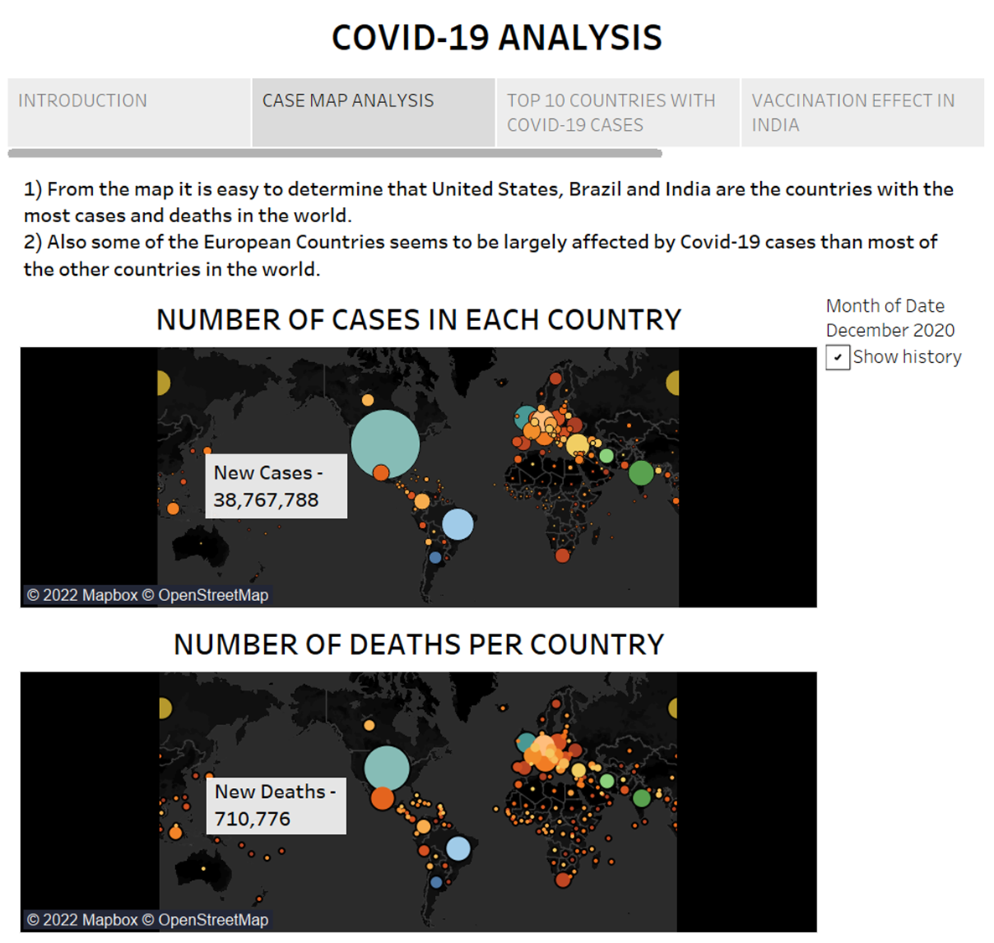
Visualization Map of Covid 19 Cases: The visual would depicts the countries that were infected by covid-19 virus?

Slide 6
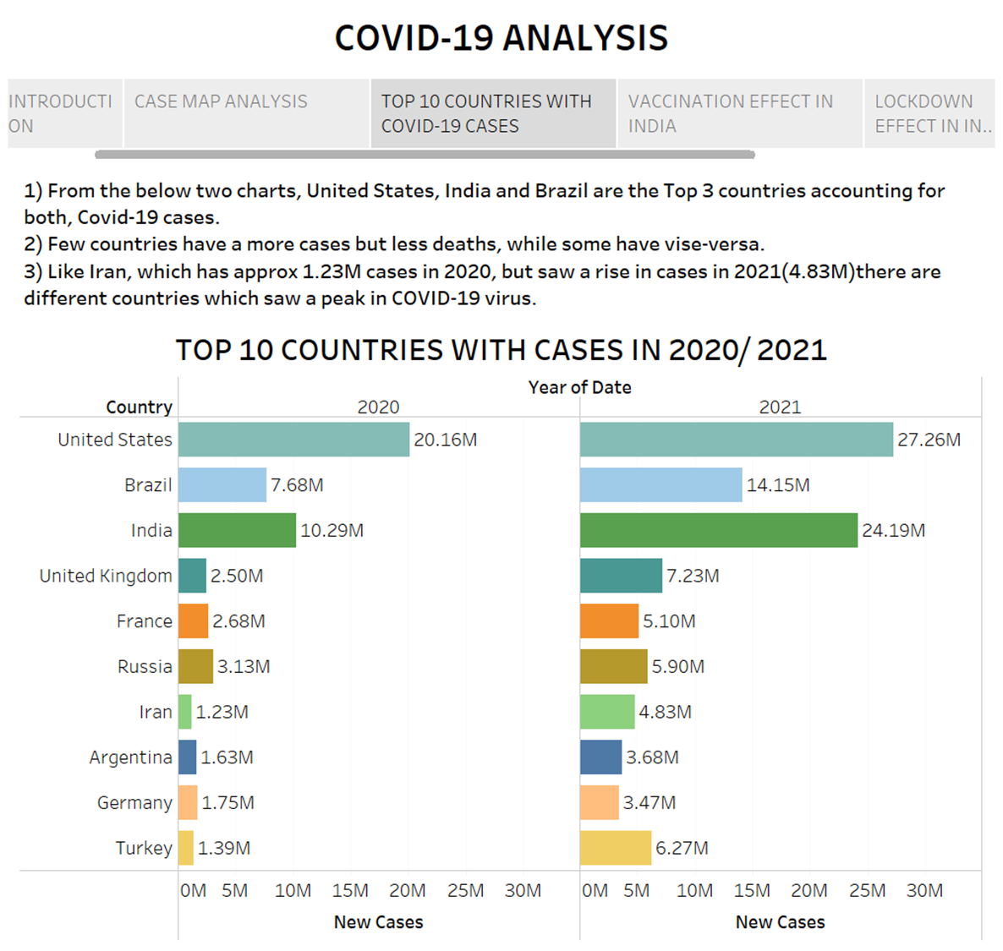
Countries with highest cases: To display top 5 countries with most covid cases from January 2020 till September 2021?

Slide 7
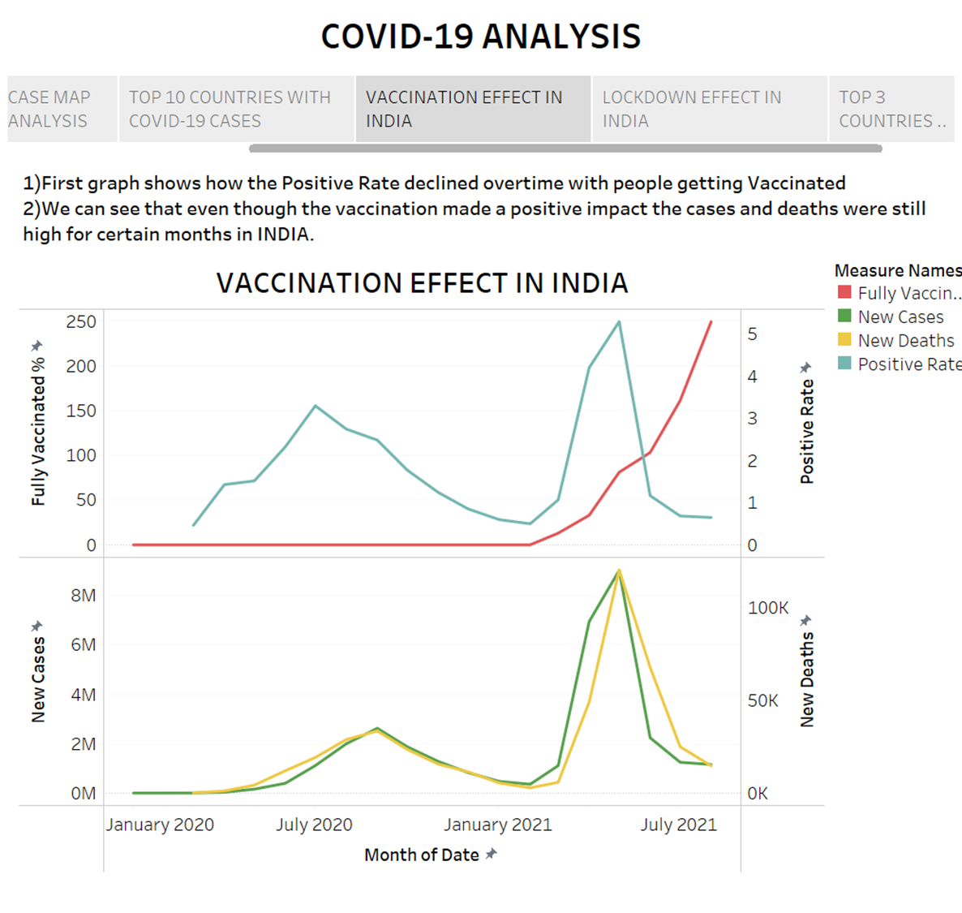
Analysis comparing the vaccination percentage with the positive rate and also new cases and deaths reported over the span of the two quarters (Q1 & Q2)?

Slide 8
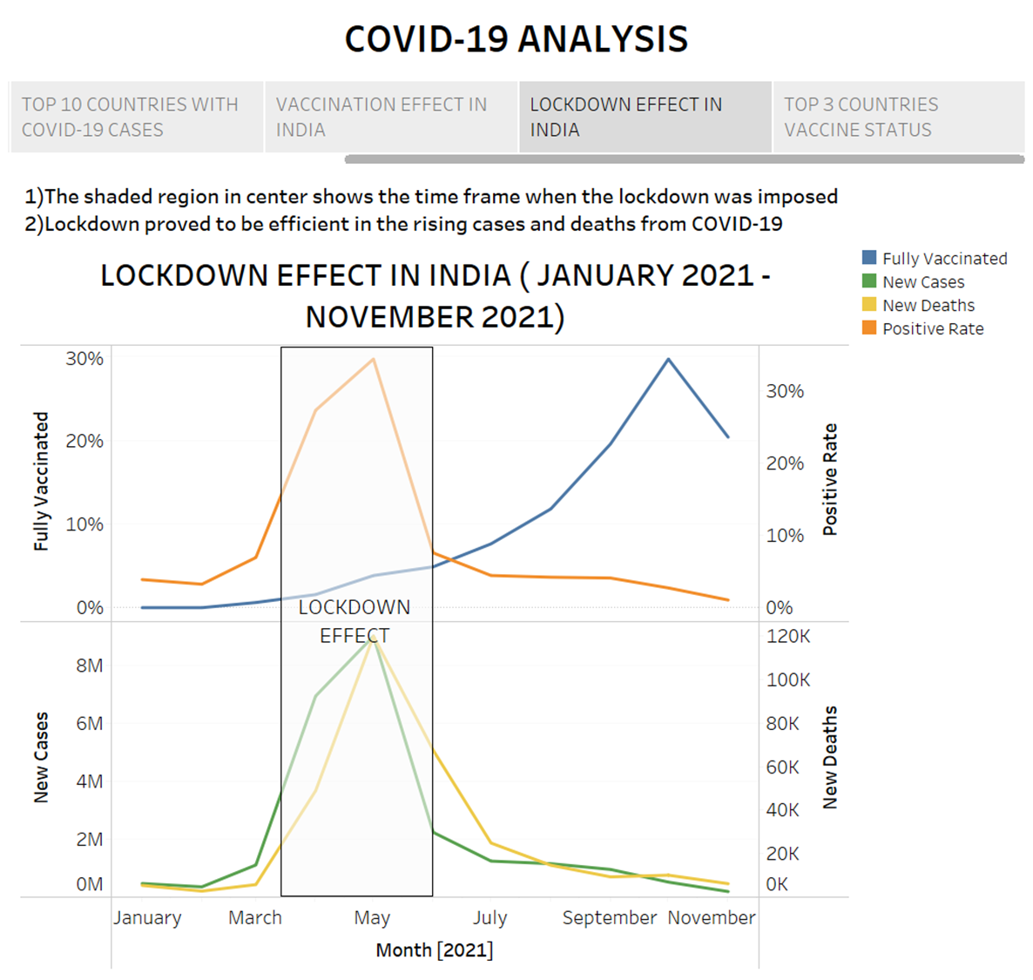
How lockdown effect seems to have a positive effect on mitigating the covid 19?

Slide 9
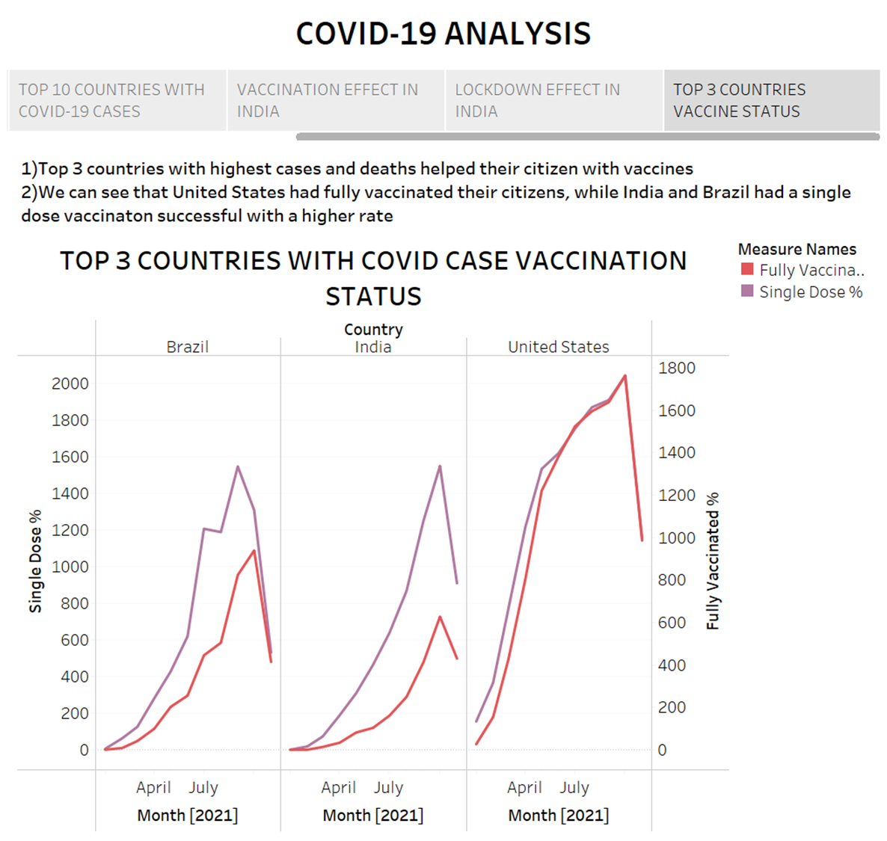
Comparison between the percentage of People vaccinated with single dose and fully vaccinated for the top 3 countries with the most covid 19 cases?

Slide 10
Thank You!

